Slide 1


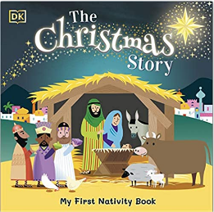
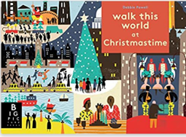
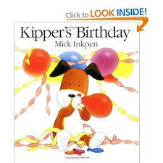
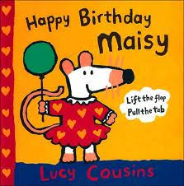

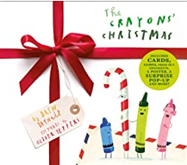
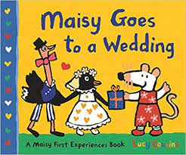
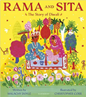

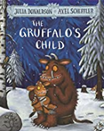

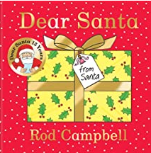
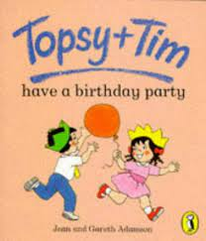

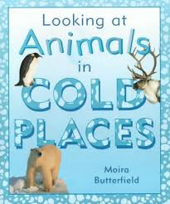



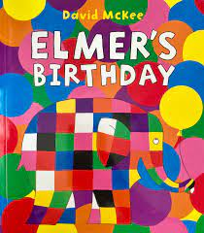

Autumn 2: Knowledge organiser
Key books this term
Bonfire Night and Diwali week 1- 2
Celebrations week 3 - 4
Hot and Cold Places week 5 - 6
Nativity - week 7
Christmas - week 8
Key Vocabulary:
Hanukah: A Jewish festival
A Hanukkah menorah: A candle that is lit to celebrate Hanukkah
Christmas : A Christian festival
Nativity :The birth of Jesus
Yuletide: A term for Christmas celebrations.
Carols – Songs sang at Christmas time.
Frankincense – A type of incense with a strong smell.
Mistletoe: A plant that we have at Christmas time.
Key Questions:
When do we celebrate Hanukkah?
When do we celebrate Christmas?
How do people in different families celebrate Christmas?
Where was Jesus born?
Who was at Jesus’ birth?
Why do Christians celebrate Christmas?
Why do Jews celebrate Hanukkah?
Key Vocabulary:
St Nicholas : A name for Father Christmas
Father Christmas / Santa : A magical man that delivers presents on the 25th December
Christmas Tree: A tree that is decorated at Christmas time.
Tinsel: A shiny decoration used to decorate houses at Christmas time.
Snowman: A snow sculpture shaped like a person.
Woodland: land covered with woods; forest.
Conker: a brown, inedible nut encased in a spiky husk produced by a horse chestnut tree.
Woodland: land covered with woods; forest.
Key Questions:
When do we celebrate Christmas?
What changes happen in au
How do you celebrate Christmas?
What season does Christmas take place in.
What happens to the weather at Christmas?
What is Christmas like in different parts of the world?
Key Vocabulary:
Birthday: A celebration of the day you were born.
Age: How old you are.
Wedding: A ceremony or celebration that involves two people getting married.
Church: A religious building for Christian worship.
Mosque: A religious building used by Muslims
Party: A celebration with music and food.
Key Questions?
What is a wedding?
What is a wedding?
What different types of religious buildings are there?
What parties and celebrations have you and your family been to?
What are your experiences and memories of birthdays?
What do you wear to different celebrations?
What food would you have at a party?
Key Vocabulary:
Habitat: A place where something makes a home.
Desert: A large area with very little rain.
Hot and Cold: Different temperatures
Arctic:: A polar region located at the northernmost part of Earth
-Animals – A living thing that is not a human or a plant.
City – A place where lots of people live closely together.
Earth: A planet that travels around the sun.
People: A human being that can be a baby, child, or adult.
Town: An area with people bigger than a village and smaller than a city.
Key Questions?
What is a desert? Can we name some? Find on a map?
What animals live in the desert?
What animals live in hot / cold places?
Where do animals live? - Habitats
Where in the world?
Key Vocabulary:
Festivals: A day or period of time of celebration usually linked to a religion.
Diwali : A Hindu festival of light.
Danger : the possibility of suffering harm or injury.
Halloween : The night of the 31st October . The eve of All Saints Day.
Bonfire night: a festival on 5th November in memory of the Gunpowder plot.
Fireworks: a device containing gunpowder which causes colourful explosions
Key Questions?
What is a festival?
What festivals and family celebrations do you take part in?
What do we do at school?
What do we do to keep ourselves safe around fire and fireworks?
Who are Rama and Sita?
Where in the world do different festivals and celebrations take place?
Who is Guy Fawkes?
What makes us unique?
What makes us special?

Slide 2





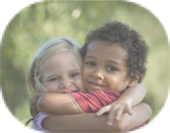
Physical Development
Mathematics
We follow the white rose scheme for maths, incorporating numicon and number blocks to support our maths learning.
Knowledge and understanding of the world
Fine motor:
Name writing
The children will continue to practice writing their names, following the arrows to ensure they start their letters in the correct place and have the correct formation.
Funky Fingers
      The children will have activities on their table that will focus on their fine motor skills. Examples of this: Playdoh, threading, drawing, stencils, scissor skills and games. These fine motor skills help the children to develop their hand muscles and support their pencil formation.
Patterns:
Odd one out
We will explore patterns and concepts behind patterns.
We will look at what the similarities are and what the odd one out might be.
Numbers
We will continue to learn our numbers and represent them in different ways. Using objects, ten frames and number lines. We will play games that involve counting and numbers.
Greater than and less than
We will be looking at quantities asking questions .
Which is greater? Which is fewer? Which is the same?
In play
In play the children will improve their fine motor skills they will do this whilst using construction, dressing dolls, threading and a range of other activities that will be out in provision.
Self care
Encourage your children to dress themselves – doing up coats, zips, buttons, shoes.
Eating – using cutlery, opening lunch boxes and food bags. Hygiene – cleaning teeth, brushing hair, toileting.
Capacity
We will look at capacity of different things looking at Equal/not equal, amount, how many?
The natural world
We will look at the changes that occur when the seasons change from Autumn to Winter. We will
Matching
The children will explore matching- can you find my other half?
Is it the same?
AT HOME: Pencil grips- We will be teaching the children to write using a tripod grip- please encourage this at home. Encourage the children to be independent as possible. Try to use cutlery and eat independently.
Gross motor
Children use their gross motor skills to perform every day functions, such as walking and running, playground skills (e.g. climbing) and sporting skills (e.g. catching, throwing and hitting a ball with a bat). We will practice these skills during PE sessions and in the outside area.
People and communities:
We will be talking about different festivals and celebrations and how different families celebrate.
  AT HOME: Practice counting and looking for numbers in the world around them.
PSED
Expressive arts and design
Relationships
We will continue to encouragee the children to make relationships with peers and with the adults. We will ensure the children feel safe, and know who they can talk to if they have any worries or needs.
Literacy- Reading and writing
Phonics
This year we be using a phonics scheme called ‘Little Wandle Letters and Sounds’. The big focus is to help the children to be able to read by Christmas. We will teach the children key skills over the Autumn term to help them to achieve this. Year 1 children will now begin to learn Phase 5 phonemes and tricky words.
Role play we will be acting out the Christmas Nativity. We will also busy ourselves in Santa’s workshop pretending to prepare for Christmas.
Past and Present
We will share our memories of celebrations we have had in our families in our past.
Oral blending
Blending in phonics is combining broken up sounds to make a word.
For example, you hear ‘p-i-g’ and you merge these sounds together to make the single word ‘pig’. It is a key skill of early reading.
  AT HOME: Practice asking your children if they would like something: for example- Would you like the M-I-L-K?
Sounds
  We will be learning these sounds (phonemes) for each of the letter of the alphabet, linking each sound to its letter (grapheme).
  We will also be learning the capital letter than corresponds with the sound.
  This will be supported by learning a handwriting rhyme for each letter to help with letter formation.
Rainbow charts
  We will introduce our class reward system- this is where children are moved up onto the rainbow for good choices and behaviour.
Art
  AT HOME: Talk to your children about celebrations you have in your family. .
Class rules
We continue to reinforce the class rules with the children.
Segmenting
This is the process of breaking down the words into separate sounds and syllables. For example ro-bot.
Tricky words: These are words that you cannot sound out, they have a tricky part- for example: said. The tricky part is the ‘ai’ making the ‘e’ sound.
Construction The children have access to a range of constructional resources in the classroom. Including the introduction of junk modelling.
  AT HOME:These are the sounds and tricky words that we will be learning this half term. Please practice at home.
Extras:
*FS2 and KS1
Christmas Play
Topics
Week 1&2 Bonfire Night and Diwali
Week 3 & 4 Celebrations
Week 5 & 6 Hot and Cold Countries
Week 7 & 8 Christmas
  We will begin to read and write simple words with the sounds that we learn. For example sat, at, pin, pip, pan, sad, mat. The children will do this on whiteboards on the carpet, during phonics and literacy session and have opportunities during choosing time.
  Jigsaw This terms focus is: …….
Music We will begin to use the musical instruments to tap out tunes and beats to a song and sing along . We will also enjoy a music session with Piano Pete.
  AT HOME: Talk to your children about ways we can be a really good friend.
  AT HOME: Try and tap out a beat to a favourite song. .

