Slide 1
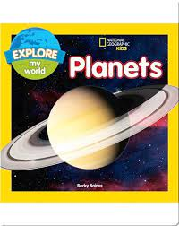


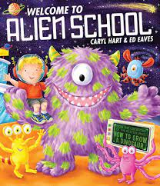




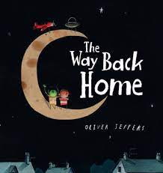
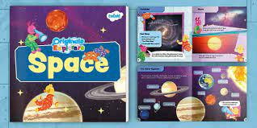

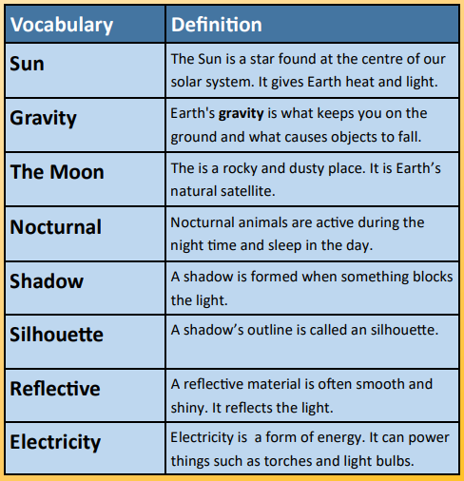
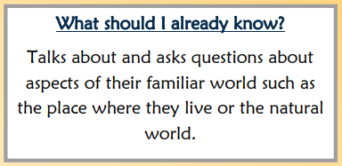

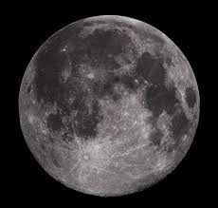
Spring 1: Knowledge Organiser
Key books this term
Can’t You Sleep Little Bear Week 1
The Moon Landing Week 2
Whatever Next Week 3
Aliens Love Underpants Week 4
The Way Back Home Week 5&6
The sun
The sun provides us with heat and light needed to power planet Earth. We will learn more about this powerful light sources and why we need the sun
Light Sources
What other light sources do we use in our everyday lives? Where do we get the power from to turn on lights and torches?
The Moon
We will step into the moon boots of the very first Astronaut to land on the Moon – Neil Armstrong. We will learn about space travel and the Moons surface. What is gravity? How is the moon different to Earth.
Shadows
We will learn that shadows form when something is blocking out the light. We will have fun making shadow art!

Slide 2







Physical Development
Mathematics
We follow the White Rose scheme for maths, incorporating Numicon and number blocks to support our maths learning.
Knowledge and understanding of the world
Fine motor:
Name writing
The children will continue to practice writing their names, following the arrows to ensure they start their letters in the correct place and have the correct formation.
Funky Fingers
      The children will have activities on their table that will focus on their fine motor skills. Examples of this: Playdoh, threading, drawing, stencils, scissor skills and games. These fine motor skills help the children to develop their hand muscles and support their pencil formation.
Numbers
We will continue to learn our numbers and represent them in different ways. Using objects, ten frames and number lines. We will play games that involve counting and numbers.
Greater than and less than
We will be looking at quantities asking questions .
Which is greater? Which is fewer? Which is the same?
Patterns:
Odd one out
We will explore patterns and concepts behind patterns.
We will look at what the similarities are and what the odd one out might be. We will begin to recognise odd and even numbers.
Self care
Encourage your children to dress themselves – doing up coats, zips, buttons, shoes.
Eating – using cutlery, opening lunch boxes and food bags. Hygiene – cleaning teeth, brushing hair, toileting.
Capacity
We will look at capacity of different things looking at Equal/not equal, amount, how many?
The natural world
We will look at the changes that occur when the seasons change from Autumn to Winter. We will look at nocturnal and diurnal animals.
In play
In play the children will improve their fine motor skills they will do this whilst using construction, dressing dolls, threading and a range of other activities that will be out in provision.
Matching
The children will explore matching-
can you find my other half?
Is it the same?
Composition of number
The children will explore composition of number to 5. They will find different ways to make five using Numicon, counters, dolls, frogs in pond and bean nags and hoops and buckets.
People and communities:
We will be talking about Chinese New Year and the new moon. To know that people in different countries speak different languages.
Shape
The children will explore shapes and begin to name squares, triangles, rectangles and circles and recognise their properties.
AT HOME: Pencil grips- We will be teaching the children to write using a tripod grip- please encourage this at home. Encourage the children to be independent as possible. Try to use cutlery and eat independently.
Gross motor
Children use their gross motor skills to perform every day functions, such as walking and running, playground skills (e.g. climbing) and sporting skills (e.g. catching, throwing and hitting a ball with a bat). We will practice these skills during PE sessions and in the outside area.
  AT HOME: Practice counting and looking for numbers in the world around them.
PSED
Expressive arts and design
Relationships
We will continue to encourage the children to make relationships with peers and with the adults. We will ensure the children feel safe, and know who they can talk to if they have any worries or needs.
Literacy- Reading and writing
Phonics
This term we will continue to learn phonics through ‘Little Wandle Letters and Sounds’. We are now introducing group reading and we are embedding the childrens key skills this term to help them become fluent readers. Year 1 children will now begin to learn Phase 5 phonemes and tricky words.
Past and Present
We will learn about the Moon landing and the first astronaut to land on the Moon Neil Armstrong.
Oral blending
Blending in phonics is combining broken up sounds to make a word.
For example, you hear ‘p-i-g’ and you merge these sounds together to make the single word ‘pig’. It is a key skill of early reading.
  AT HOME: Practice reading at least 3 times a week with your child.
Sounds
  We will be learning these sounds (phonemes) for each of the letter of the alphabet, linking each sound to its letter (grapheme).
  We will also be learning the capital letter than corresponds with the sound.
  This will be supported by learning a handwriting rhyme for each letter to help with letter formation.
Role play we will be acting out the Moon landing and Whatever Next. We will also busy in our spaceship role play pretending to carry out jobs on the Moon.
Working Together
The children will work together this term to achieve spots on their team chart. Once their chart is completed they will choose a group treat!
  AT HOME: Talk to your children about different countries and languages that are spoken there..
  AT HOME:Please practise the home learning sheet with your child. This covers the sounds and tricky words we have learnt through out the week.
Tricky words: These are words that you cannot sound out, they have a tricky part- for example: said. The tricky part is the ‘ai’ making the ‘e’ sound.
Class rules
We continue to reinforce the class rules with the children.
Construction The children have access to a range of constructional resources in the classroom. Including the introduction of junk modelling.
Segmenting
This is the process of breaking down the words into separate sounds and syllables. For example ro-bot.
Extras:
Parent
Phonics workshop
19th Januray
Topics
Week 1 – Can’t you sleep little bear
Week 2 – The Moon Landing
Week 3–Way Back Home
Week 4 – Whatever NextThe
Week 5 Aliens Love Underpants
Week 6 – Chinese New Year
  Jigsaw This terms focus is Dreams and Goals.
Music We will begin to use the musical instruments to tap out tunes and beats to a song and sing along . We will also enjoy a music session with Piano Pete.
  We will begin to read and write simple words with the sounds that we learn. For example sat, at, pin, pip, pan, sad, mat. The children will do this on whiteboards on the carpet, during phonics and literacy session and have opportunities during choosing time.
  AT HOME: Talk to your children about ways we can be a really good friend.
  AT HOME: Try and tap out a beat to a favourite song. .

