Slide 1






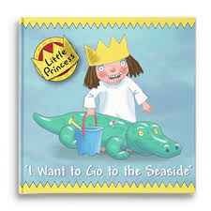








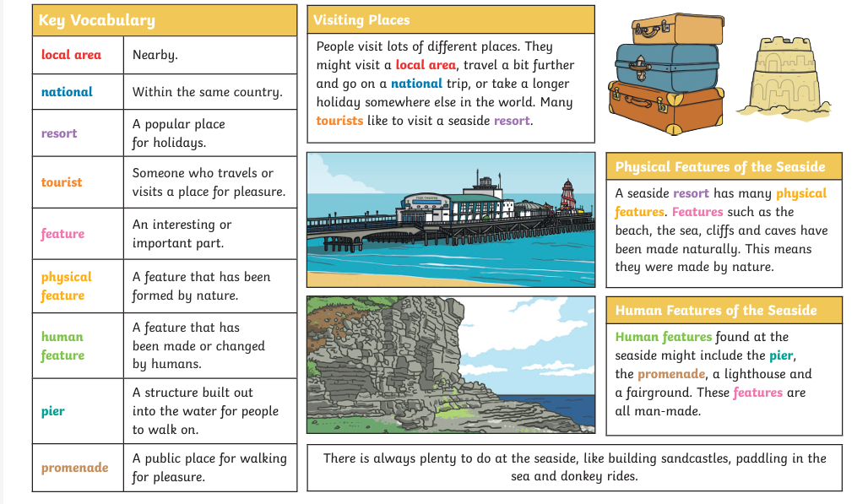
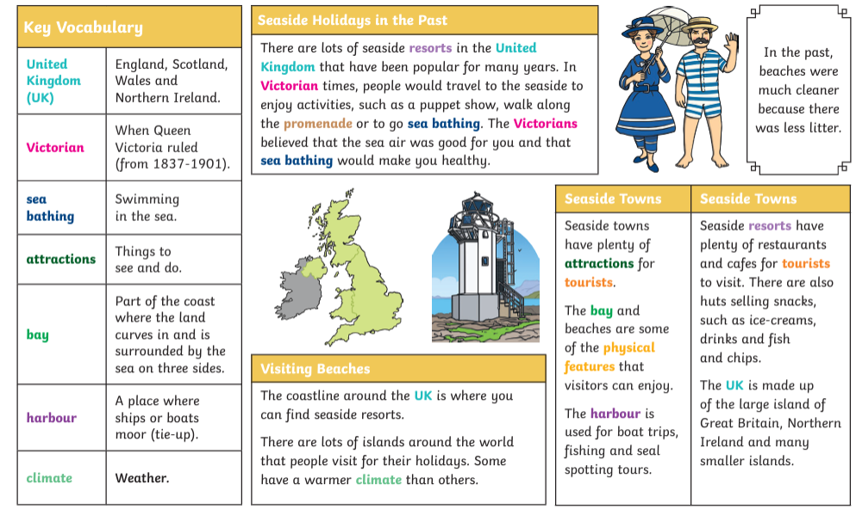
Summer 2: Knowledge Organiser
Key books this term
Week 1 and 2 Going to the seaside and how it has changed
Week 5 The Snail and The Whale and
Rainbow Fish and other fishy stories
Week 3- Non-fiction Under the Sea
Week 4 Commotion in the ocean
Pirates and Mermaids- Week 6 and 7

Slide 2
