Slide 1
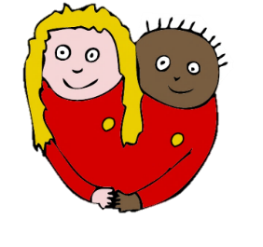
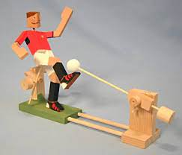

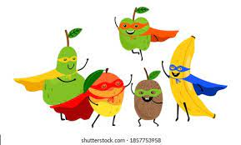


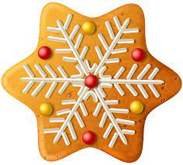

Redland Design Technology Journey
????
???
???
Toys
Healthy Me
Early Years
Owls & Wrens
Key Stage 1
Robins & Starlings
Nutrition Ninjas
Sky Scrapers
Key Stage 2
Puffins & Nightingales
Buzzards & Hawks
Moving Toys
Christmas Enterprise
Kingfishers & Falcons
Programming Pioneers
Great British Bake Off
Shown is the progression of the D.T topics throughout the school. Children will learn about the topics as they move throughout the school.

