Slide 1
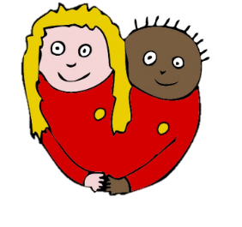
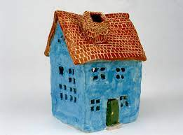
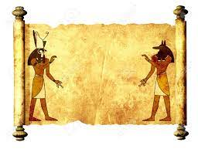
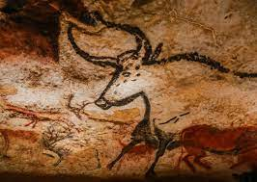
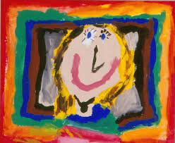
Redland Art Journey
Make your mark & clay houses
Tell a story & Colour splash.
Marvellous me
Animal kingdom
Early Years
Owls & Wrens
Key Stage 1
Robins & Starlings
Growing artists & Fabric of nature.
Clay houses & Egyptian scrolls
Key Stage 2
Puffins & Nightingales
Light and dark, interactive installations.
I need space & prehistoric painting
Buzzards & Hawks
Kingfishers & Falcons
Portraits & making memories.
Make my voice heard, architecture.
Shown is the progression of the Art topics throughout the school. Children will learn about the topics as they move throughout the school.

